Slide 1
TEAM EQUINOX
Citibank HackOverflow

Slide 2
Problem Statements
Design an application for both clients and bankers that positions Citi as the modern bank for wealth management solutions, to drive client acquisition and strengthen client relationships in the Asian market.

Slide 3
Problem Statements
Design an application for both clients and bankers that positions Citi as the modern bank for wealth management solutions, to drive client acquisition and strengthen client relationships in the Asian market.

Slide 4
Problem Statements
Design an application for both clients and bankers that positions Citi as the modern bank for wealth management solutions, to drive client acquisition and strengthen client relationships in the Asia-Pacific market.

Slide 5
Problem Statements
Design an application for both clients and bankers that positions Citi as the modern bank for wealth management solutions, to drive client acquisition and strengthen client relationships in the Asia-Pacific market.

Slide 6
Problem Statements
Design an application for both clients and bankers that positions Citi as the modern bank for wealth management solutions, to drive client acquisition and strengthen client relationships in the Asia-Pacific market.

Slide 7
Problem Statements
Design an application for both clients and bankers that positions Citi as the modern bank for wealth management solutions, to drive client acquisition and strengthen client relationships in the Asia-Pacific market.

Slide 8
Problem Statements
Design an application for both clients and bankers that positions Citi as the modern bank for wealth management solutions, to drive client acquisition and strengthen client relationships in the Asia-Pacific market.

Slide 9
To tackle that, we propose…
…a MOBILE APP

Slide 10


Tech Stack
Frontend
Backend

Slide 11
But…
Tech Stack
Why a mobile app?
Frontend
Backend

Slide 12
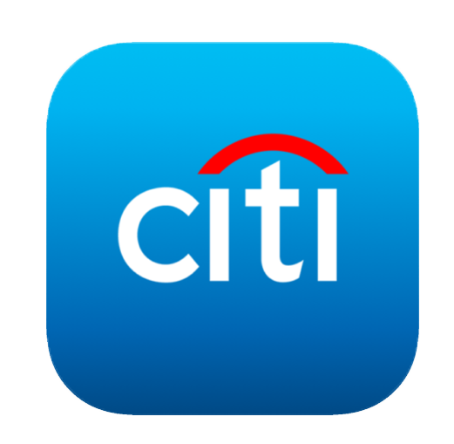

But…Why a mobile app?
Complements CITI App
Convenient

Slide 13
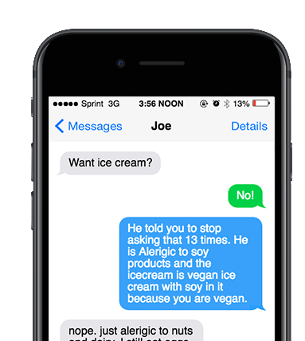
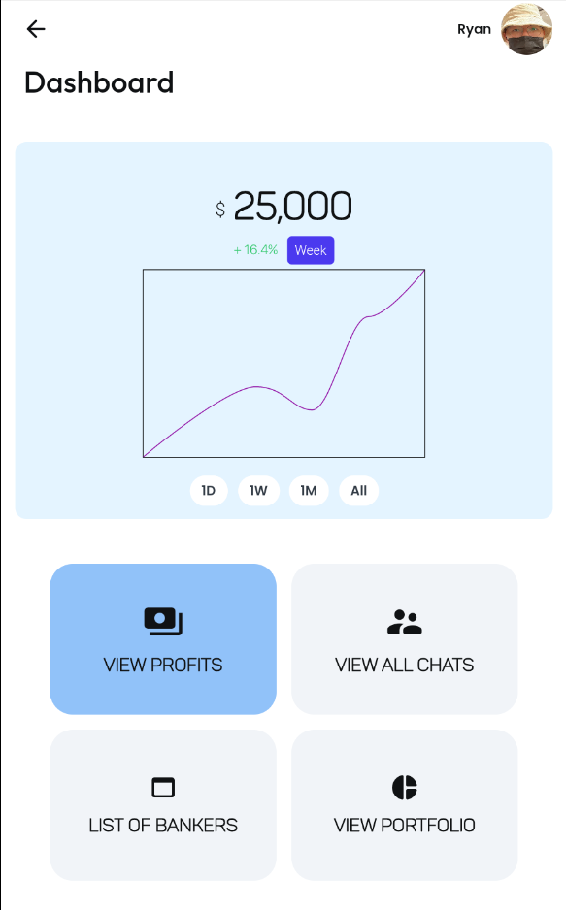
Dashboard to give bankers and clients
EASY ACCESS
to important info

Slide 14
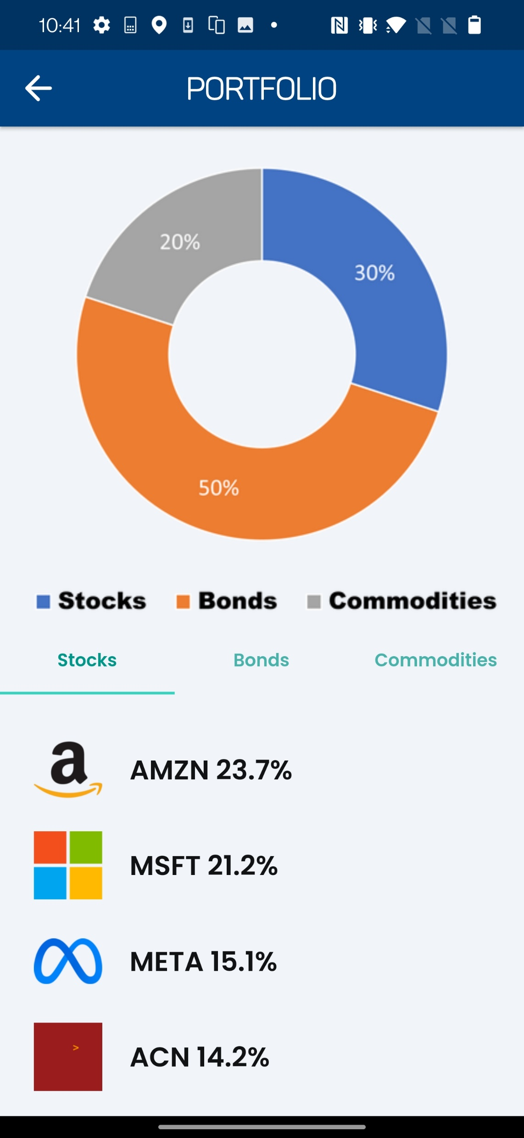
Convenient access to portfolio enables transparency and increases trust

Slide 15
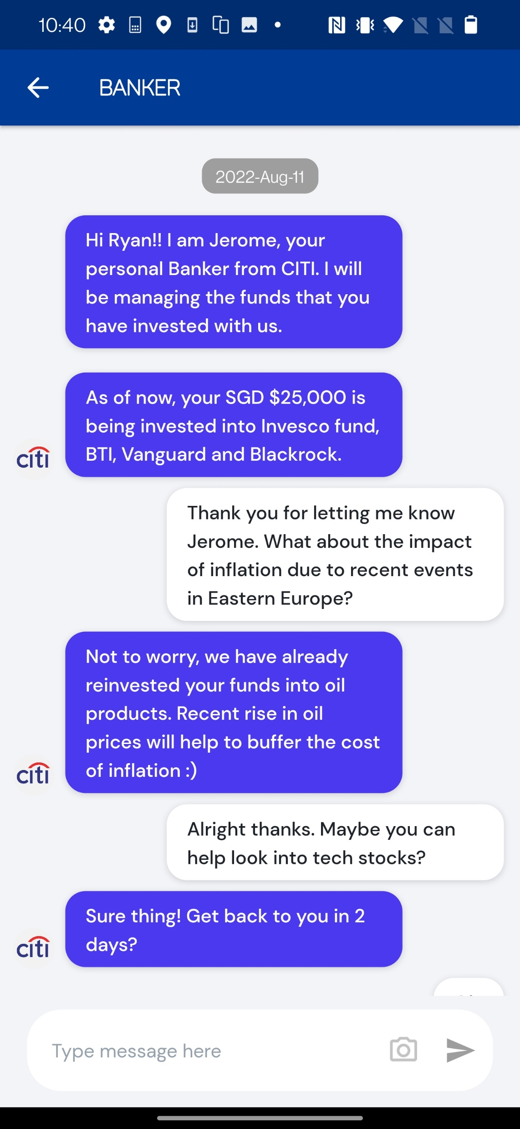
In-app Chat Strengthens RELATIONSHIP between banker and client

Slide 16
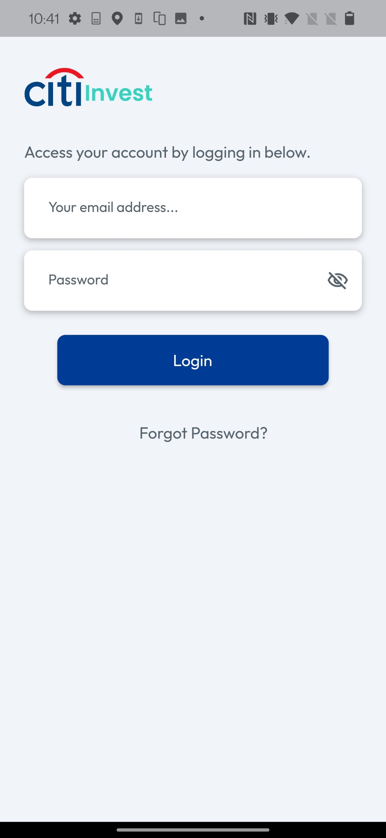
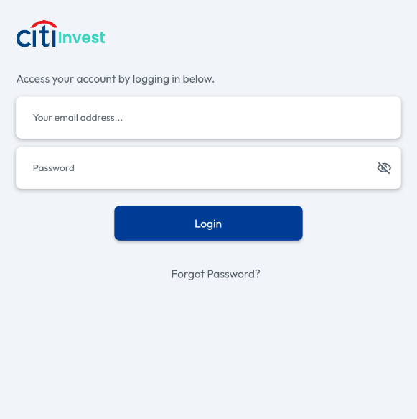
Login is seamless

Slide 17
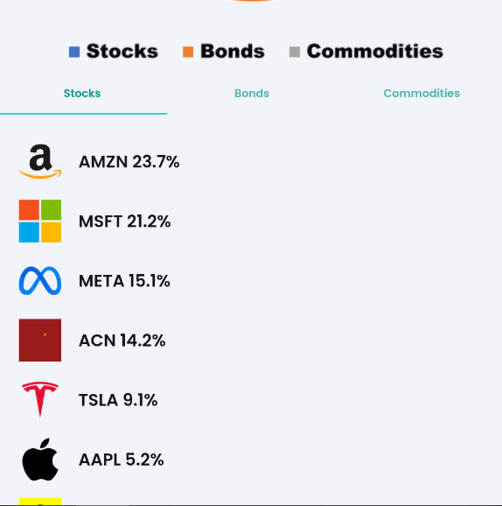
As a Client…

Slide 18
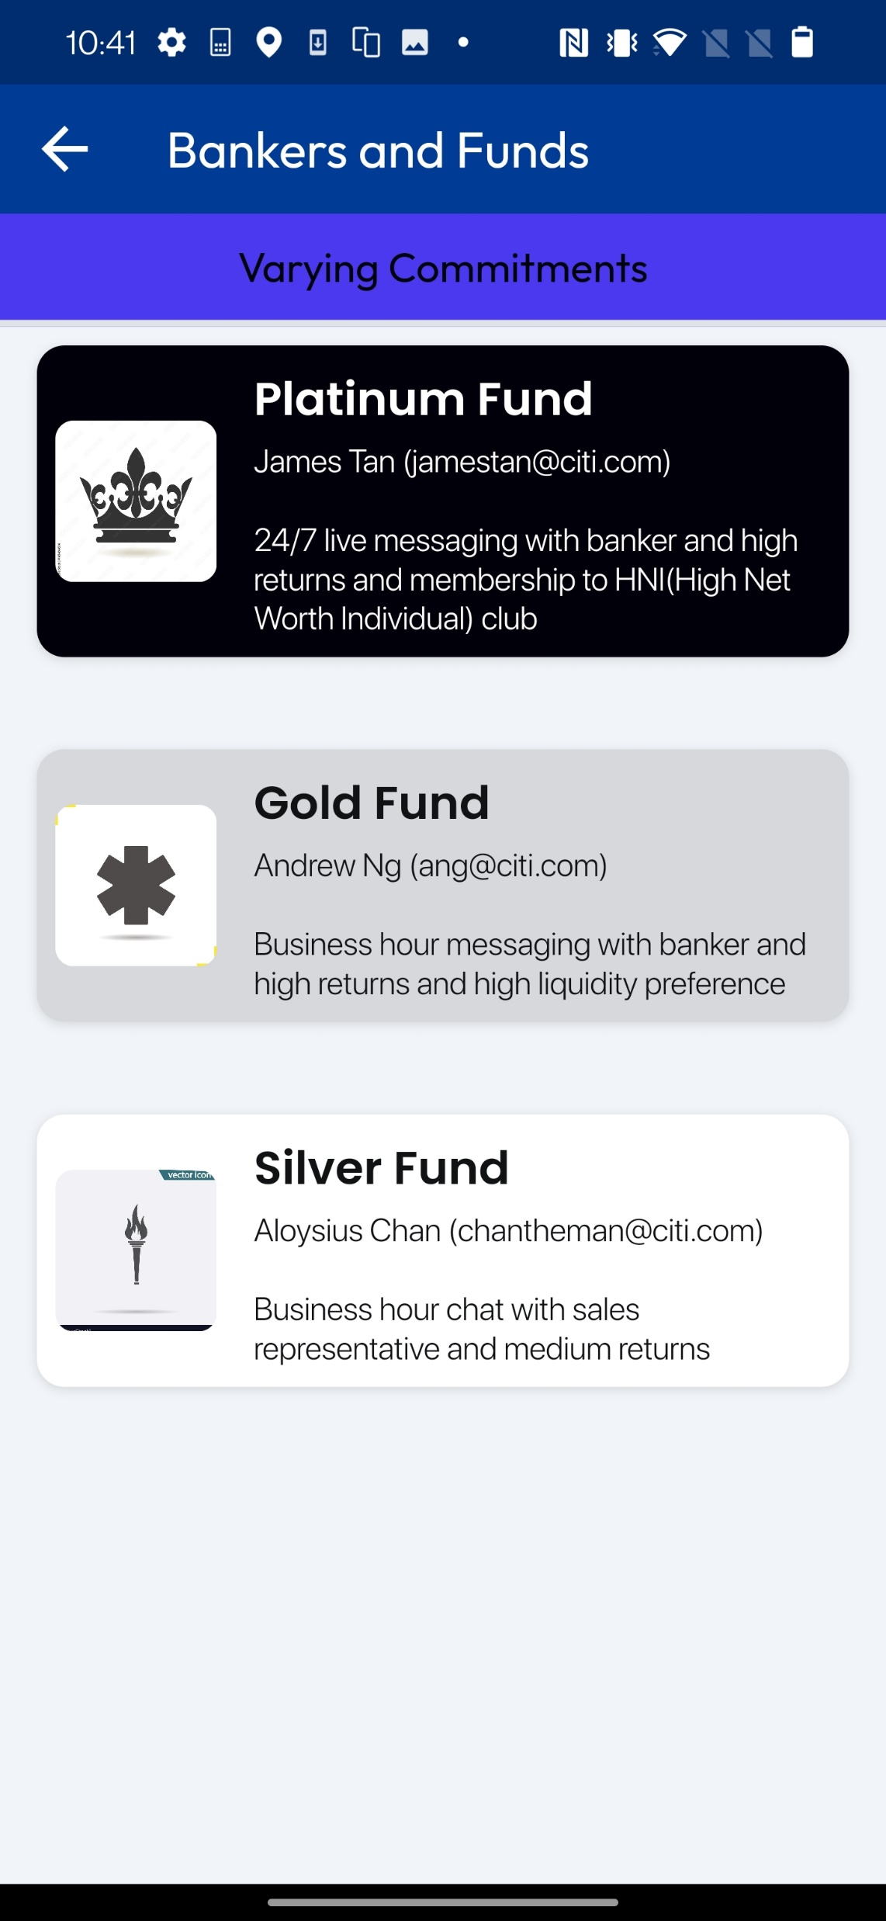
As a Client…

Slide 19
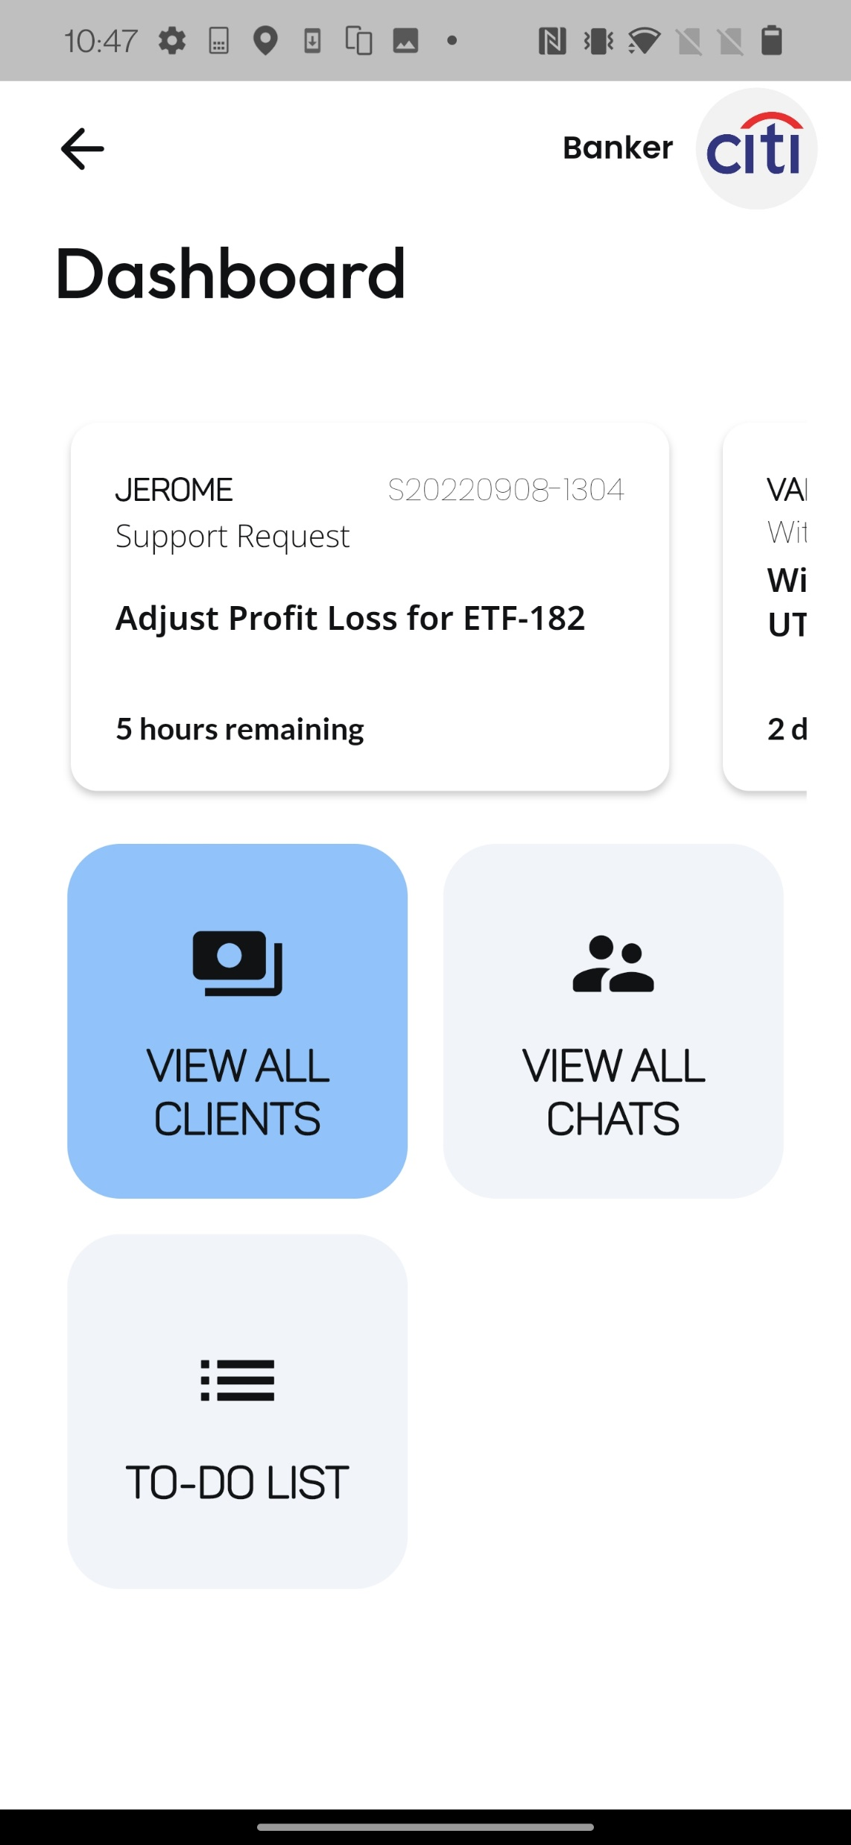
As a Banker…

Slide 20
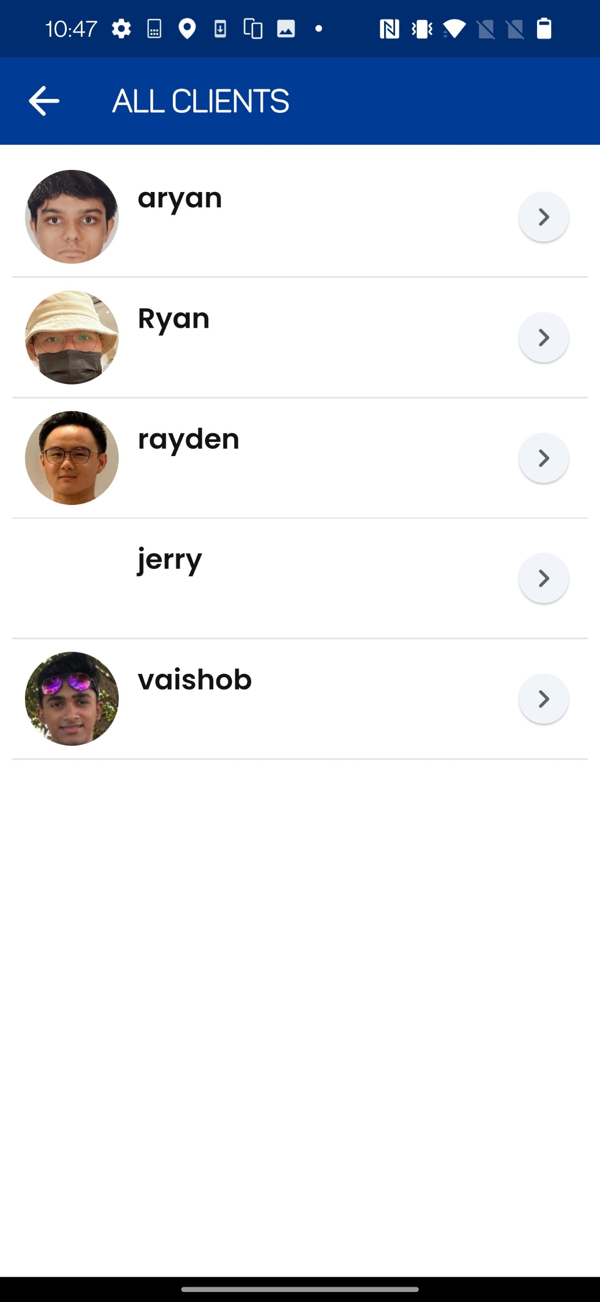
As a Banker…

Slide 21
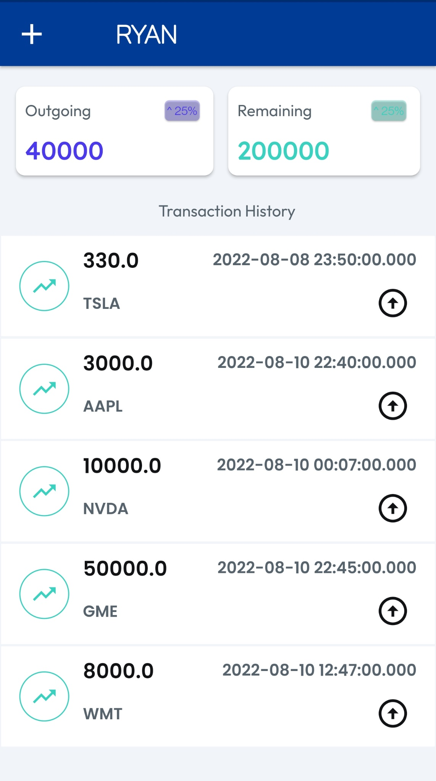
As a Banker…

Slide 22
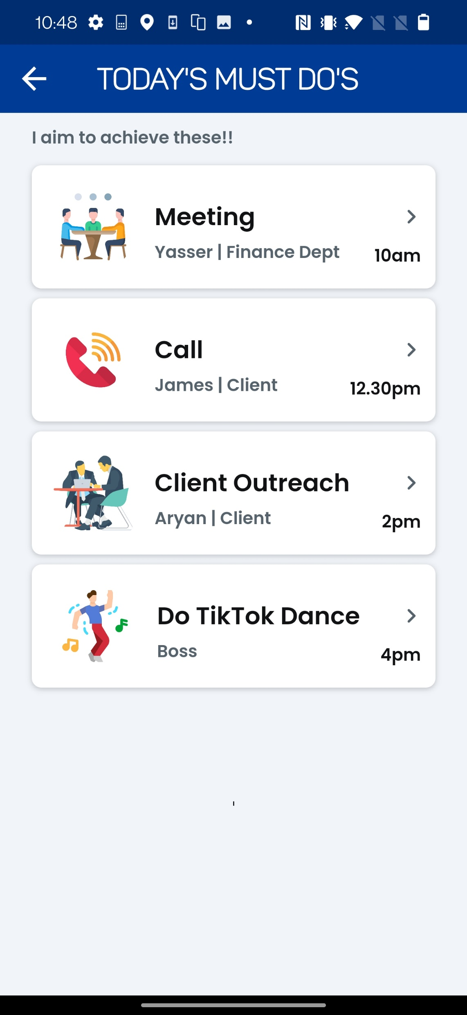
As a Banker…

Slide 23
Credentials
Banker
Usn: banker@citi.com
Pwd: hello123
Client:
ryan@gmail.com
Pwd: hello123

Slide 24




Whats Next?
Realtime Data
Commercial DB
Tiktok Integration
Migrate to Cloud

Slide 25

Thank you!
Realtime Data
Commercial DB
Tiktok Integration
Migrate to Cloud

